Slide 1
MATLAB Programming
Midterm Two
Instructor: 黃世強 (Sai-Keung Wong)

Slide 2
Midterm instruction
There are two parts of an exam.
1) the programming part (total 90pt)
You must implement a program to solve each problem
2) the report part (total 10pt)
You must write a report to describe how you solve each problem
The approach for solving each problem must be clear and readable.
It contains a structure plan and shows clearly why such approach is adopted.
Each report must contain the number of words between 80 and 120 words in English. The marking scheme of the report is based on the correctness and clarity of the description of the approach. If you use fewer words to describe the approach, your score may be deducted.

Slide 3
Content
There are four questions. You must answer all of them.
Each program must be interactive. Deduct 5pt if the program is too slow to run.

Slide 4
About demo video
A demo video may have bugs. The demo video shows roughly the results. These results may not be exactly the same as the requirements. They are for your own reference. You must follow the instruction to finish your programs.

Slide 5
Program file name format
Write all your programs in a folder. The folder name is mat_midterm02_student_ID. For example, if your ID is 12345678, the folder name is mat_midterm02_12345678.
Zip the folder and upload it.
Write a program for each problem in one file.
The file name is m02_X_yourStudentID.m, where X is the problem number.
For example, if your student ID is 12345678 and the problem number is 3, then the file name must be m02_3_12345678.m.
You must not output all the intermediate results.
Output the results that are required only.

Slide 6
File content header
At the top of the file, write down your name, ID, email address, department, and date.
%%%%%%%%%%%%%%%%%%%%%%%%%%%
% Midterm Number: …
% Problem number: …
% Student Name: …
% Student ID: …
% Email address: …
% Department:
% Date: ….
%%%%%%%%%%%%%%%%%%%%%%%%%%%%

Slide 7
File content
For each problem, display the problem number before showing the results.
close all; clear; clc; % close all windows
% clear variables, and clear screen
disp('Midterm Problem 2.1') % show Midterm Problem 2.1

Slide 8
(20%) Problem 2.1. Curve Filling
There are two curves which are plotted in the polar and Cartesian coordinate systems, respectively.
Write a program to reproduce the animation result which must be similar to the example. The colors can be different from the example.
Curve 1 (must be in the polar coordinate system):
a = 10;
x = [-4*pi:0.1:-eps eps:0.1:pi*4];
r = a * sin(x) / x;
Curve 2 (must be in the Cartesian coordinate system):
a = 5; b = 15; t = [0:0.1:6*pi];
x = (a+b)cos(t) – b*cos((a/b+1)t)
y = (a+b)sin(t) – b*sin((a/b+1)t)

Slide 9
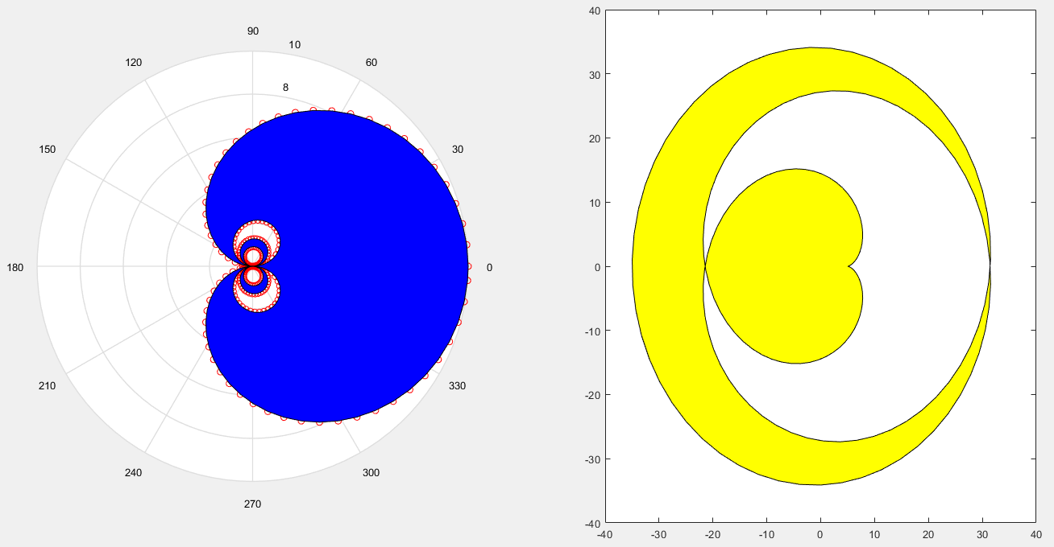
Curve 1
Curve 2

Slide 10
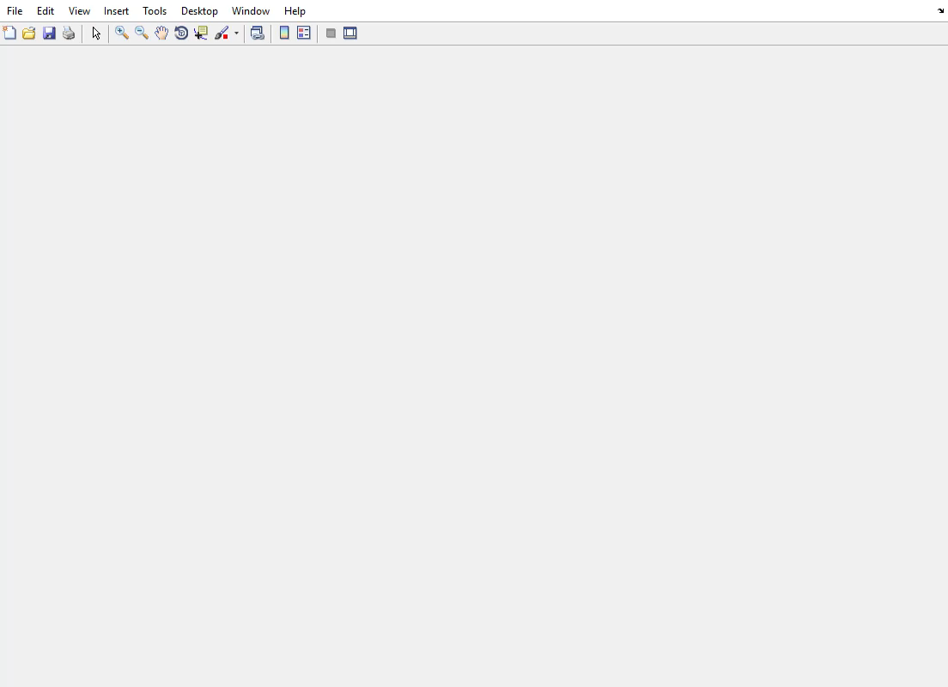
Curve 1
Curve 2
Play to see the animation.

Slide 11
Problem 2.1 Marking scheme
[4%] The first curve is drawn in the Polar coordinate system.
[4%] The second curve is drawn in the Cartesian coordinate system.
[6%] The region is filled correctly for the first curve in an animation.
[6%] The region is filled correctly for the second curve in an animation.

Slide 12
(20%) Problem 2.2. Curve interpolation and extrapolation
Given two parametric functions:
Set t = -10:0.025:10. The step size can be adjusted but the curves must be smooth.
We can interpolate the two functions as follows:
x(t) = (1-k) x1(t) + k x2(t)
y(t) = (1-k) y1(t) + k y2(t).
k can be computed in two ways. Thus, we produce the animation process to interpolate the two functions in two plots. Let h = 0:0.01:1. The two ways are:
k = 2*h*sin(h*2*pi), and k = sin²(k1*pi/2), where k1 = 2*h*sin(h*2*pi).
Ask to press ENTER before the animation is generated. The animation result must be similar to the example. There must be two plots (use subplots). Each plot shows one interpolation result. The animation must be smooth and interactive. Make sure that the figure window is on top.
Function 1 (Lissajous Curve) x1(t) = a1 * sin( n1*t + c1 ); y1(t) = b1 * sin( t ); a1 = 10; b1 = 5; c1 = 0; n1 = 4; t is the independent variable. | Function 2 (Nephroid) x2(t) = a2 * ( 3 cos(t) – cos(3t) ); y2(t) = a2 * ( 3 sin(t) – sin(3t) ); a2 = 5;

Slide 13
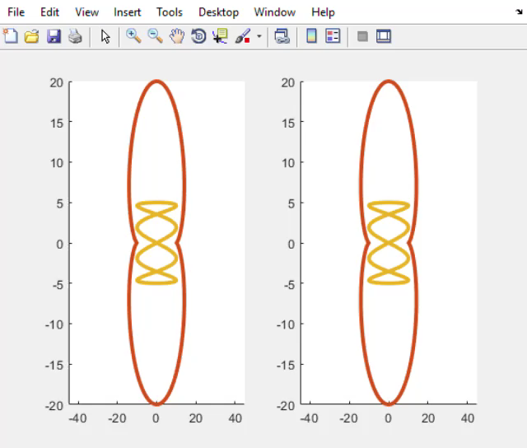
Problem 2.2
Play to see the animation.

Slide 14
Problem 2.2 Marking scheme
[5%] The interpolation is correct in the first plot.
[5%] The interpolation is correct in the second plot.
[5%] The animation is smooth and interactive.
[5%] The curves are correct and the colors of the curves are appropriate.

Slide 15
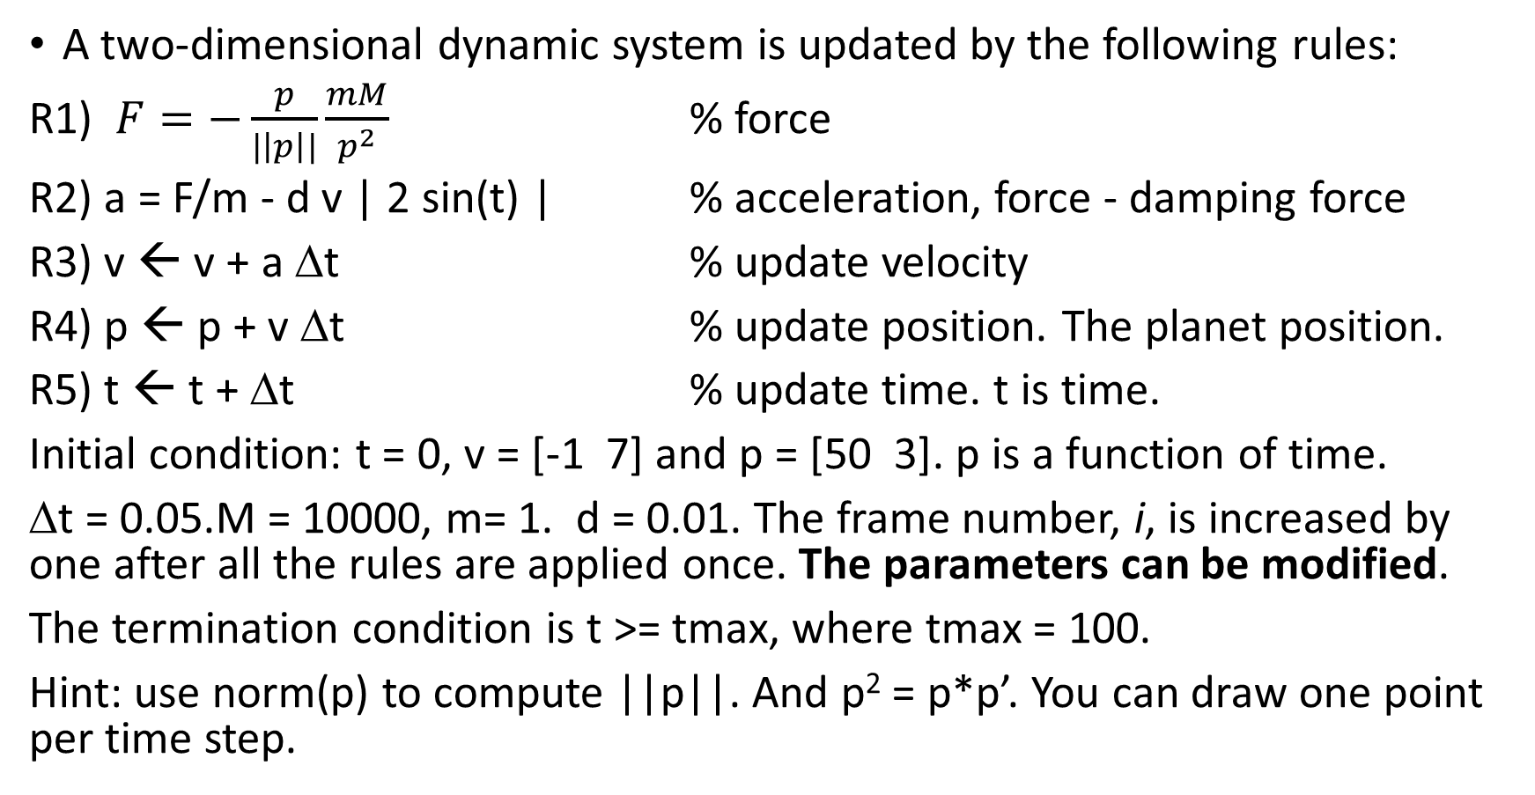
(25%) Problem 2.3. Planet trajectory and travel length
A two-dimensional dynamic system is updated by the following rules:
R1) $F=−\frac{p}{|\left|p\right||}\frac{mM}{p^{2}}$ % force
R2) a = F/m - d v | 2 sin(t) | % acceleration, force - damping force
R3) v ← v + a Δt % update velocity
R4) p ← p + v Δt % update position. The planet position.
R5) t ← t + Δt % update time. t is time.
Initial condition: t = 0, v = [-1 7] and p = [50 3]. p is a function of time.
Δt = 0.05.M = 10000, m= 1. d = 0.01. The frame number, i, is increased by one after all the rules are applied once. The parameters can be modified.
The termination condition is t >= tmax, where tmax = 100.
Hint: use norm(p) to compute ||p||. And p² = p*p’. You can draw one point per time step.

Slide 16
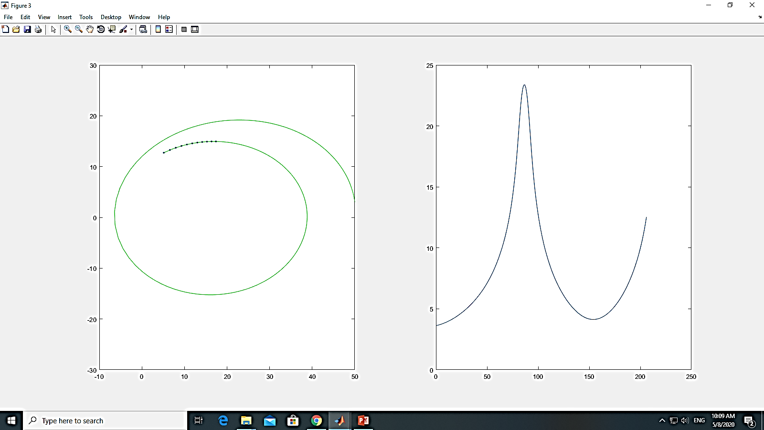
Problem 2.3
Draw the trajectory of the planet. The planet must be rotating around the origin (0,0) at the beginning.
Draw N recent sample points of the trajectory of the planet.

Slide 17
Problem 2.3
Collect the most recent N sample points of the planet trajectory. Compute the length of the curve segment formed by these N points. N must be at least 8.
Plot the length of the curve segment vs the frame number, i.
If the length cannot be computed for a small i, the plot is skipped.
Hint:
Assume that the coordinates (x, y) o the sample points are stored in q.
If N = 4, we have
dq = q(i-3:i-1, :) - q(i-2:i,:);
d2 = dq(:,1).*dq(:,1) + dq(:,2).*dq(:,2);
d1 = sqrt(d2);
sd = sum(d1); % total length

Slide 18
Problem 2.3
Length of the curve segment vs. frame number
The planet trajectory
y
x
frame number

Slide 19
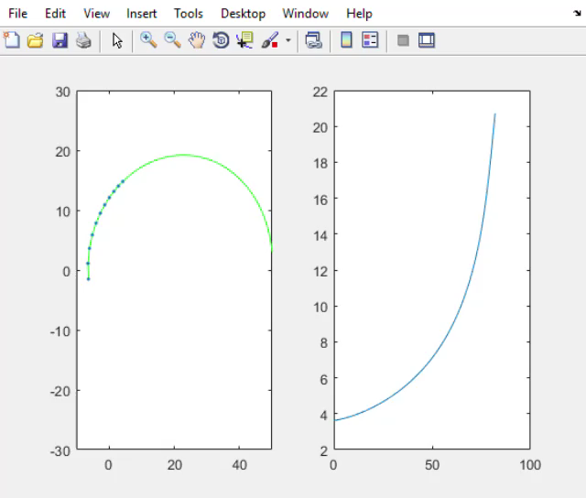
Problem 2.3
Play to see the animation.

Slide 20
(25%) Problem 2.3 Marking scheme
[5%] The trajectory of the planet is similar to the example.
[5%] The plot for the length of the curve segment is similar to the example.
[5%] The recent sample points are plotted clearly, at least 8 points.
[5%] The results can be seen clearly, including trajectory and the plot of the curve length.
[5%] The trajectory of the planet is similar to the example and the performance of the program must be interactive.

Slide 21
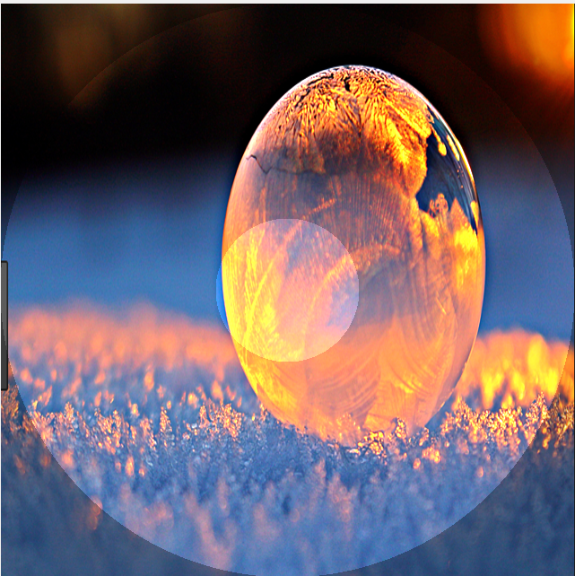
(25 pts) Midterm Problem 2.4. Image manipulation
This program manipulates the image, tmp.png. You can resize the image as long as the objects are clear in the image. You press keys to manipulate the image. Note that if the image is brightened up, its effect should be on when the image is being shifted.
You should use the template: m02_4.m. Change file name.
The template only uses the key ‘j’ only.
The results must be similar to the results in the demo video.
Show the options for the key usage as follows:
j) Shift the image from right to left by 10 pixels per step
k) Shift the image from left to right by 10 pixels per step
n) Shift the image from right to left by 40 pixels per step
m) Shift the image from left to right by 40 pixels per step
b) Turn on or off a spot light on the center. Raise or reduce the intensities of pixels in a circular ring (formed by two circles). The region inside the smaller circle is much brighter than the region between the two circles.
q) Show student name and ID. Then quit the program.

Slide 22
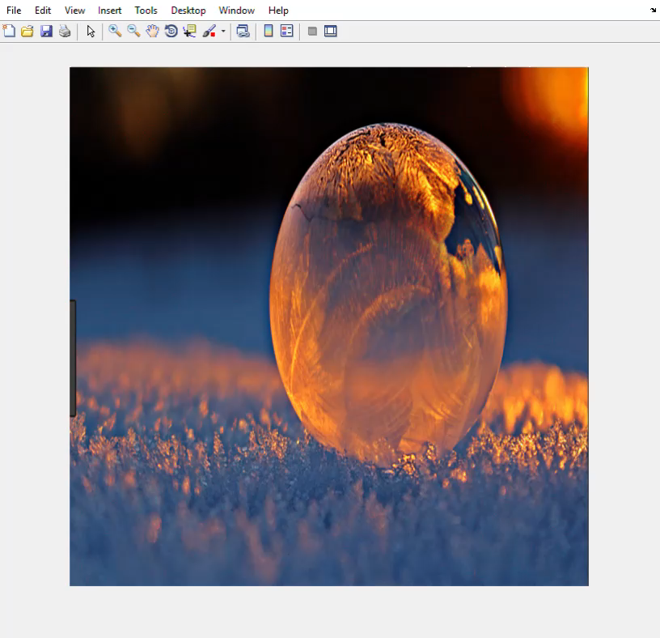
The image is shifted by 10 pixels per step
Play to see the animation.
If the effect of ‘brighten up” is on, the effect is also applied when the image is shifted.
Must use keys to manipulate the image.

Slide 23
(25 pts) Problem 2.4 Marking Scheme
The results must be similar to the results in the demo video.
The objects in the image must be maintained.
[2%] j) Shift the image from right to left by 10 pixels per step
[2%] k) Shift the image from left to right by 10 pixels per step
[2%] n) Shift the image from right to left by 40 pixels per step
[2%] m) Shift the image from left to right by 40 pixels per step
[6%] b) The effect of “Brighten up” is correct.
[10%] if the image is brightened up, its effect should be on when the image is being shifted. All cases (i.e., shifting images) must be correct.
[1%] q) Show student name and ID. Then quit the program.

Slide 24
End
Enjoy MATLAB Programming.

